Slide 1
BLM267
Chapter 7: Stacks

Slide 2
Introduction to Stacks
Array Representation of Stacks
Operations on a Stack
Linked Representation of Stacks
Operations on a Linked Stack
Multiple Stacks
Application of Stacks

Slide 3
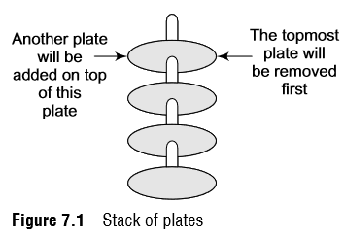
Introduction to Stacks
Stack is an important data structure which stores its elements in an ordered manner.
We will explain the concept of stacks using an analogy.
You must have seen a pile of plates where one plate is placed on top of another as shown in Fig. 7.1.
Now, when you want to remove a plate, you remove the topmost plate first.
Hence, you can add and remove an element (i.e., a plate) only at/from one position which is the topmost position.

Slide 4
Introduction to Stacks
A stack is a linear data structure which uses the same principle, i.e., the elements in a stack are added and removed only from one end, which is called the TOP.
Hence, a stack is called a LIFO (Last-In-First-Out) data structure, as the element that was inserted last is the first one to be taken out.
Now the question is where do we need stacks in computer science?
The answer is in function calls.
Consider an example, where we are executing function A.
In the course of its execution, function A calls another function B.
Function B in turn calls another function C, which calls function D.

Slide 5
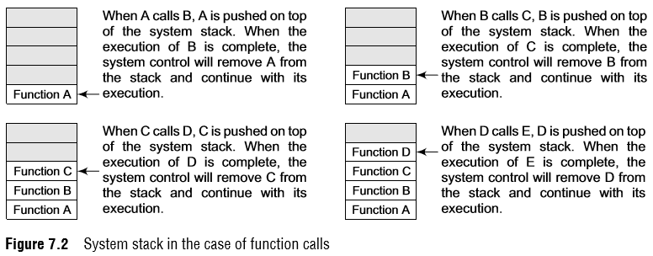
Introduction to Stacks
In order to keep track of the returning point of each active function, a special stack called system stack or call stack is used.
Whenever a function calls another function, the calling function is pushed onto the top of the stack.
This is because after the called function gets executed, the control is passed back to the calling function.
Look at Fig. 7.2 which shows this concept.

Slide 6
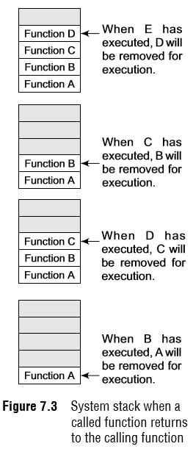
Introduction to Stacks
Now when function E is executed, function D will be removed from the top of the stack and executed.
Once function D gets completely executed, function C will be removed from the stack for execution.
The whole procedure will be repeated until all the functions get executed.
Let us look at the stack after each function is executed.
This is shown in Fig. 7.3. The system stack ensures a proper execution order of functions.
Therefore, stacks are frequently used in situations where the order of processing is very important, especially when the processing needs to be postponed until other conditions are fulfilled.

Slide 7

Array Representation of Stacks
Stacks can be implemented using either arrays or linked lists.
Linear array.
Every stack has a variable called TOP associated with it, which is used to store the address of the topmost element of the stack.
It is this position where the element will be added to or deleted from.
There is another variable called MAX, which is used to store the maximum number of elements that the stack can hold.
If TOP = NULL, then it indicates that the stack is empty and
if TOP = MAX–1, then the stack is full.
The stack in Fig. 7.4 shows that TOP = 4, so insertions and deletions will be done at this position. In the above stack, five more elements can still be stored.

Slide 8
Operations on a Stack
A stack supports three basic operations: push, pop, and peek.
The push operation adds an element to the top of the stack and the pop operation removes the element from the top of the stack.
The peek operation returns the value of the topmost element of the stack.
Push Operation
The push operation is used to insert an element into the stack.
The new element is added at the topmost position of the stack.
However, before inserting the value, we must first check if TOP=MAX–1, because if that is the case, then the stack is full and no more insertions can be done.
If an attempt is made to insert a value in a stack that is already full, an OVERFLOW message is printed.

Slide 9


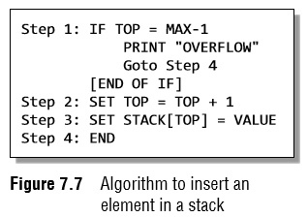
Operations on a Stack
To insert an element with value 6, we first check if TOP=MAX–1.
If the condition is false, then we increment the value of TOP and store the new element at the position given by stack[TOP].
Figure 7.7 shows the algorithm to insert an element in a stack.
In Step 1, we first check for the OVERFLOW condition.
In Step 2, TOP is incremented so that it points to the next location in the array.
In Step 3, the value is stored in the stack at the location pointed by TOP.

Slide 10
Operations on a Stack
Pop Operation
The pop operation is used to delete the topmost element from the stack.
However, before deleting the value, we must first check if TOP=NULL because if that is the case, then it means the stack is empty and no more deletions can be done.
If an attempt is made to delete a value from a stack that is already empty, an UNDERFLOW message is printed.

Slide 11
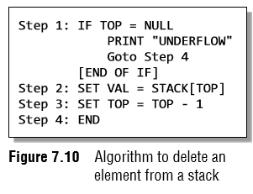


Operations on a Stack
Pop Operation
To delete the topmost element, we first check if TOP=NULL. If the condition is false, then we decrement the value pointed by TOP.
Thus, the updated stack becomes as shown in Fig. 7.9.
Figure 7.10 shows the algorithm to delete an element from a stack.
In Step 1, we first check for the UNDERFLOW condition.
In Step 2, the value of the location in the stack pointed by TOP is stored in VAL.
In Step 3, TOP is decremented.

Slide 12
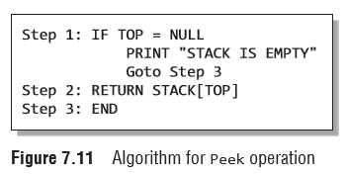

Operations on a Stack
Peek Operation
Peek is an operation that returns the value of the topmost element of the stack without deleting it from the stack.
The algorithm for Peek operation is given in Fig. 7.11.
However, the Peek operation first checks if the stack is empty, i.e., if TOP = NULL, then an appropriate message is printed, else the value is returned.
Consider the stack given in Fig. 7.12.
Here, the Peek operation will return 5, as it is the value of the topmost element of the stack.

Slide 13
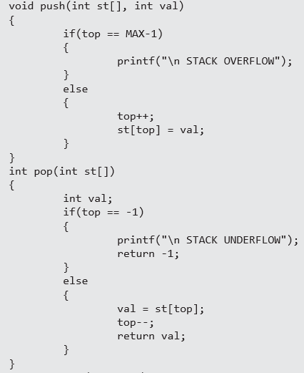
Operations on a Stack

Slide 14
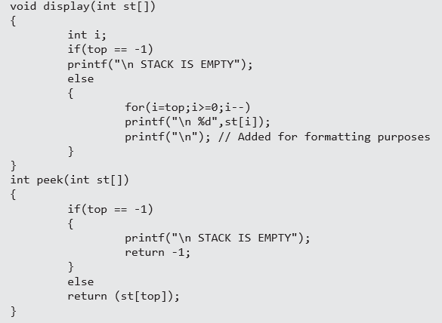
Operations on a Stack

Slide 15
Linked Representation of Stacks
This technique of creating a stack is easy, but the drawback is that the array must be declared to have some fixed size.
In case the stack is a very small one or its maximum size is known in advance, then the array implementation of the stack gives an efficient implementation.
But if the array size cannot be determined in advance, then the other alternative, i.e., linked representation, is used.

Slide 16

Linked Representation of Stacks
In a linked stack, every node has two parts—one that stores data and another that stores the address of the next node.
The START pointer of the linked list is used as TOP.
All insertions and deletions are done at the node pointed by TOP. If TOP = NULL, then it indicates that the stack is empty.
The linked representation of a stack is shown in Fig. 7.13.

Slide 17


Operations on a Linked Stack
Push Operation
The push operation is used to insert an element into the stack.
The new element is added at the topmost position of the stack. Consider the linked stack shown in Fig. 7.14.
To insert an element with value 9, we first check if TOP=NULL.
If this is the case, then we allocate memory for a new node, store the value in its DATA part and NULL in its NEXT part.
The new node will then be called TOP.
However, if TOP!=NULL, then we insert the new node at the beginning of the linked stack and name this new node as TOP.
Thus, the updated stack becomes as shown in Fig. 7.15.

Slide 18
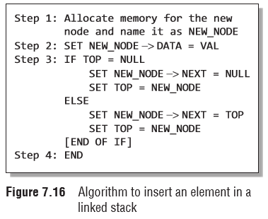
Operations on a Linked Stack
Figure 7.16 shows the algorithm to push an element into a linked stack.
In Step 1, memory is allocated for the new node. In Step 2, the DATA part of the new node is initialized with the value to be stored in the node.
In Step 3, we check if the new node is the first node of the linked list.
This is done by checking if TOP = NULL.
In case the IF statement evaluates to true, then NULL is stored in the NEXT part of the node and the new node is called TOP.
However, if the new node is not the first node in the list, then it is added before the first node of the list (that is, the TOP node) and termed as TOP.

Slide 19
Operations on a Linked Stack
Pop Operation
The pop operation is used to delete the topmost element from a stack.
However, before deleting the value, we must first check if TOP=NULL, because if this is the case, then it means that the stack is empty and no more deletions can be done.
If an attempt is made to delete a value from a stack that is already empty, an UNDERFLOW message is printed.
In case TOP!=NULL, then we will delete the node pointed by TOP, and make TOP point to the second element of the linked stack.

Slide 20
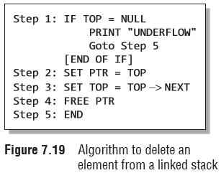


Operations on a Linked Stack
Pop Operation
Figure 7.19 shows the algorithm to delete an element from a stack.
In Step 1, we first check for the UNDERFLOW condition. In Step 2, we use a pointer PTR that points to TOP.
In Step 3, TOP is made to point to the next node in sequence.
In Step 4, the memory occupied by PTR is given back to the free pool.

Slide 21
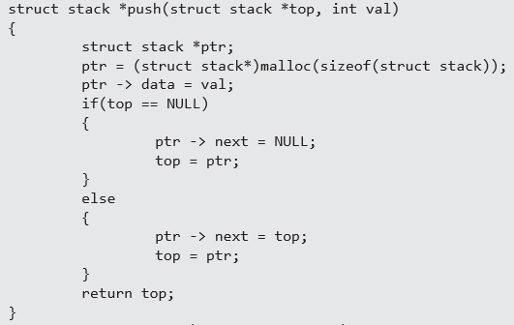
Operations on a Linked Stack

Slide 22
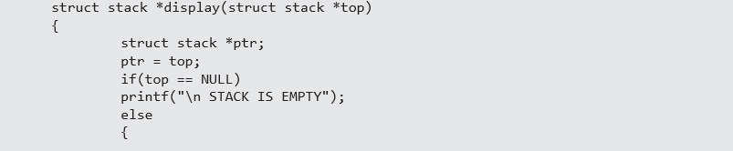
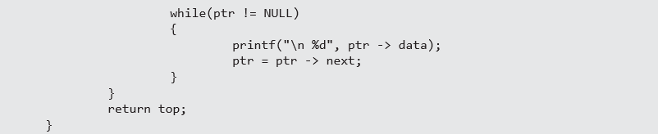
Operations on a Linked Stack

Slide 23
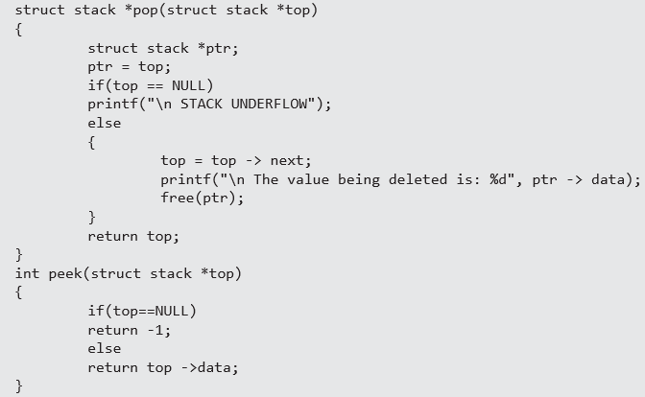
Operations on a Linked Stack

Slide 24

Multiple Stacks
While implementing a stack using an array, the size of the array must be known.
If the stack is allocated less space, then frequent OVERFLOW conditions will be encountered.
In case we allocate a large amount of space for the stack, it may result in sheer wastage of memory.
Thus, there lies a trade-off between the frequency of overflows and the space allocated.
So, a better solution to deal with this problem is to have more than one stack in the same array of sufficient size.
In Fig. 7.20, an array STACK[n] is used to represent two stacks, Stack A and Stack B.
The value of n is such that the combined size of both the stacks will never exceed n.
While operating on these stacks, it is important to note one thing—Stack A will grow from left to right, whereas Stack B will grow from right to left at the same time.

